Slide 1


Cloud for AI
Course 7: Introduction to Deployment
Filotas Theodosiou

Slide 2
What are we going to talk about today

Slide 3
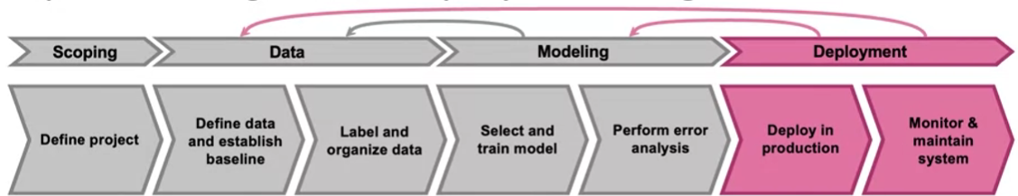
Introduction to The Deployment Stage
Deployment: Deployment is the process of integrating a trained machine learning model into a production environment to make it available for end-users.
Serving: Set-up the hardware and software to serve the model predictions on cloud or edge devices
Scalability: Ensure the model can handle varying loads from few requests to thousands per second
Versioning: Keeping track of different version of the model allowing for rollbacks, A/B tests etc
Monitoring: Monitor the performance of the model in the real world and collect feedback
Deployment is an iterative process! Feedback is used to improve the performance of the model!!

Slide 4
A “packed” Lecture!
Important for the oral exam ;)
Intro to Model Serving
Types of Model Serving
Intro to Cloud Deployment
Scaling Infrastructures
Inference
Notes:
A quick note here. This lecture has some important theoretical concepts that might be used for the Oral exams!
Lets see what we are going to review
We are going to see what is model serving
The types of models serving
We are going to make an introduction to cloud deployment
How to scale our infrastructures and finally how to effectively apply inference!

Slide 5
Model Serving
Notes:
Lets start with model serving

Slide 6
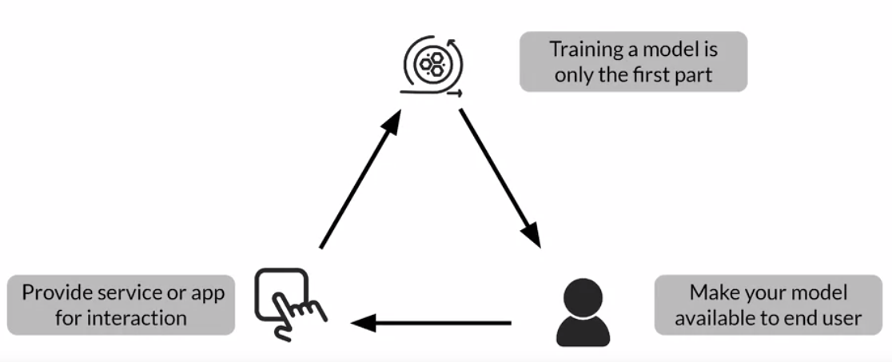
What Exactly is Model Serving?

Slide 7
What Exactly is Model Serving?
Training a good ML model serves nothing on its own

Slide 8
What Exactly is Model Serving?
Training a good ML model serves nothing on its own
You need to make it available for usage

Slide 9
What Exactly is Model Serving?
Training a good ML model serves nothing on its own
You need to make it available for usage
You do that by providing access to it through serving!

Slide 10
What Exactly is Model Serving?
Training a good ML model serves nothing on its own
You need to make it available for usage
You do that by providing access to it through serving!

Slide 11


A Case Study: Speech recognition
Mobile Phone (Edge Device)
Local Software
Speech API
Voice
Detection and
Classification
VAD
Module
Microphone
Prediction
Server
Transcript
Classification
Frontend Code
Notes:
We will talk about this later in more detail

Slide 12
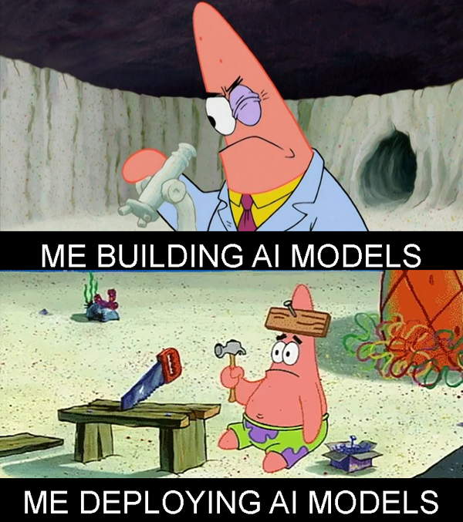
A Quick Note!
Deployment in general is the core of MLOps
A good ML engineer should be very good with deploying models!
We will talk about important theoretical concept on deployment
Later we will get familiar with some tools for model serving!

Slide 13
Model Serving Patterns
Three key components in serving a model
A fitted model
An interpreter
Input data
Used for
Inference Process
Notes:
Good. Lets see what we need to serve a model. Which are the most important components here?
We have a fitted model
We have an interpreter
And we have some input data
Pay attention here. These are used only for the inference process. Model serving is a associated with inference in our case

Slide 14
ML workflows
Make set of predictions based on historical input data
Sufficient for non-time dependant data
Model training (Offline)
Model prediction (inference)
Batch Inference
Online Inference
Predictions generated in real-time
Input data at the time of request
Notes:
To give you a reminder, there are two phases in a ML workflow
There is the model training phase, which is taking places offline. Its what we talked about in the past, how to prepare and train a model
Then we have the inference, where the fitted model is used to make predictions given some new input data
Now lets see these two types of inference
We have batch inference. In batch inference we provide our model with a batch of input data and we ask it to make predictions based on that. We apply this approach in occasions where we dont have data that is dependentant on time. We just want to make some predictions at some point. A good example is a supermarket that orders food every Monday and at Sunday night they make their model predict the demand for next week so on Monday they place their order
Then we have the online inference. Predictions for online inference are generated in real time. We have some sensor that gathers data, feeds this data to the model and the model generates predictions at real time. You can picture it as streaming. Data comes constantly, the model makes predictions. A good example is a self-driving car!

Slide 15
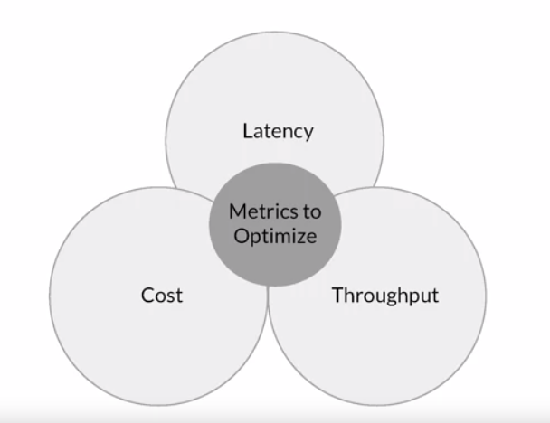
Important Serving Metrics
Notes:
Good. To measure how good our serving is we use these 3 metrics we learnt before
Latency: How fast does our model finish inference
Cost: How expensive is for our model to make predictions
Throughput: How many predictions in total does our model make in a specified time interval
As we have said there is a tradeoff between all these metrics and users should carefully decide which of these they are going to focus more on depending on their application

Slide 16
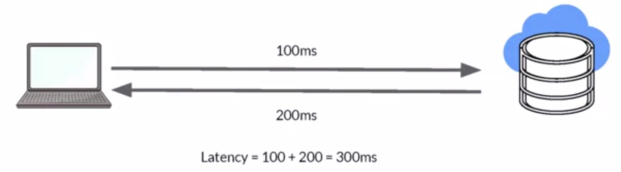
Latency
Delay between user’s action and response of application to these actions
Latency of the whole process, starting from sending data to server, performing inference using model and returning response
Minimal latency is a key requirement to maintain customer satisfaction
Notes:
Lets take them on by one.
So Latency is the time it takes for a user to make an action and get a result back.
Its the whole process from when the user makes the first click, it sends data to the main computer and then gets the results back!
It is very important that in cases where we have high latency a customer might decide to leave. We live in a period where feedback and actions happen really fast. If something does not work for the user then we have a problem

Slide 17
Throughput
Throughput -> Number of successful requests served per unit time say one second.
In some application only throughput is important not latency
Example:
Video from security cameras at high fidelity to ensure security events are spotted quickly
Notes:
Throughput as we said is the number of requests that we satisfy per unit in time. This is usually is 1 second.
In some cases , throughput is much important important than latency.
This is usually the case when we want to measure events. For example in a security camera event.

Slide 18

Cost
The cost associated with each inference should be minimised
Critical infrastructure requirements that are expensive
CPU
Hardware accelerators like GPU
Caching infrastructure for faster data retrieval
Notes:
Finally we have costs.
To measure cost we measure it per request benign satisfied.
We have to ensure that this remains controlled
To optimize inference we need to make sure what produces is stable
We have CPU, we have GPUs and we have caching for retrieving our data faster.
These are some of the hardware and the pipelines we might have to optimize our costs!

Slide 19
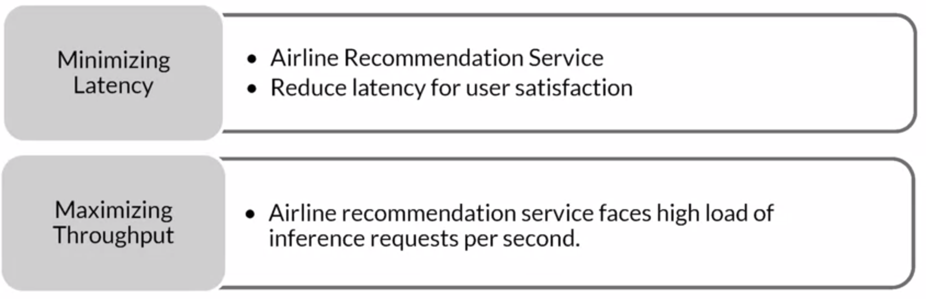
Minimizing latency, Maximizing Throughput
Notes:
Remember, when we talk about Latency our goal is to minimize it. Our goal in an airline recommendation system is to have users get their results as fast as possible
On the other hand with throughput the goal is to have satisfied as many requests as possible. For example when the server is pressaured we have to find a way to balance that so we get requests satisfied
When we measure our benchmark performance for these, our goal is to scale our infrastructures to meet our goals and requirements.
Having good hardware is essential in having good performance and thus, user satisfcation!

Slide 20

Balance Cost, Latency, and Throughput
Cost increases as infrastructure is scaled
In applications where latency and throughput can suffer slightly:
Reduce costs by GPU sharing
Multi-model serving
Optimizing models used for inference
Notes:
Allright as we said. Optimizing one, usually results in losing something from the other!
The goal is to have a good balance here. Have good inference, while ensuring our throughput remains stable!
Also always remember, when we scale our infrstarctures to host more users and requests the cost increases
Its important to find a a cost-effective way to scale here!
There are some tricks to save some money that we apply in practise
For example we can share GPUs but parallelziing or we can serve multiple models in parallels.
Finally, we can even optimize our models for inference. For example a model like GPT-4 cannot be ran on my computer. It needs huge amounts of RAM to make a simple inference. Thats why I will stick with something lighter like a LLAMA-2 with only 7b parameters. Or if even this does not work, I use some techniques to make the model lighter. Prune weights, ditiliation, change weights to float8 and so on.

Slide 21
Resources and
Requirements for
Serving Models
Notes:
Ok good! Now lets move to the next sectio.
What are the actual requirement to actual serve a model here?

Slide 22
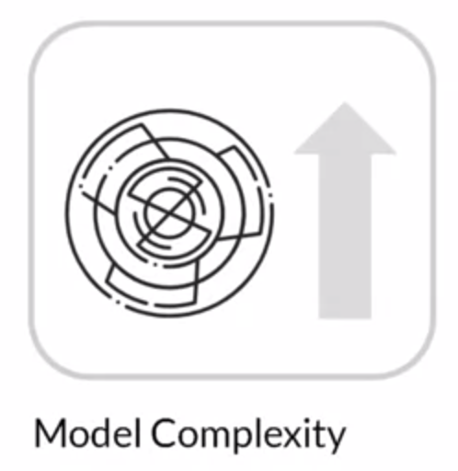
Optimizing Models for Serving
Model complexity increases
Notes:
Lets assume you want to increase your ML performance and you want to use a more powerful model like a complex NN.

Slide 23
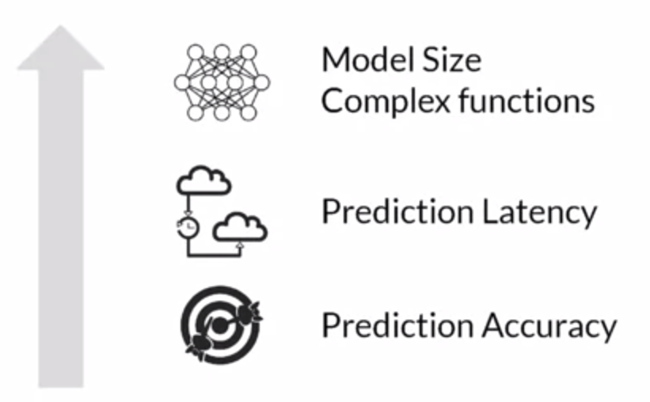
Optimizing Models for Serving
Model complexity increases
These also increase:
Notes:
By increasing the model complexity you need to be aware that other things increase too!
The model have more parameters, which ideally would lead to increase in its prediction accuracy
More importantly the model will have increased latency! More parameters -> slower model!
You cannot have it all

Slide 24
Meanwhile as Complexity Increases
Model complexity increases
Notes:
However this not only the case

Slide 25
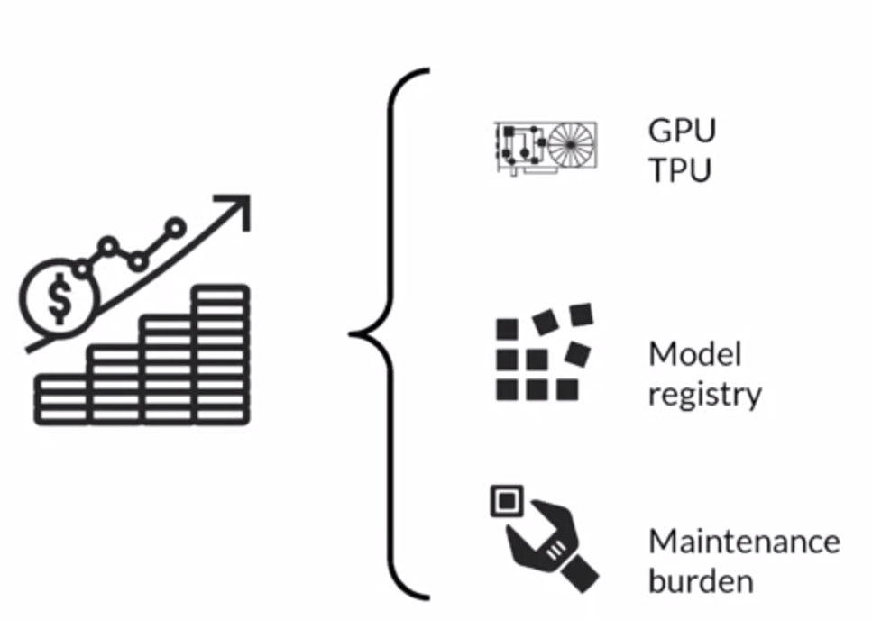
Meanwhile as Complexity Increases
Costs also do increase
Model complexity increases
Notes:
Together with complexity we can the cost increasing as well
Training a more advanced model requires more resources.
It requires a better GPU, a better TPU
It requires better Maintenance and so on.
So these are things you need to take into consideration when you scale your model!

Slide 26
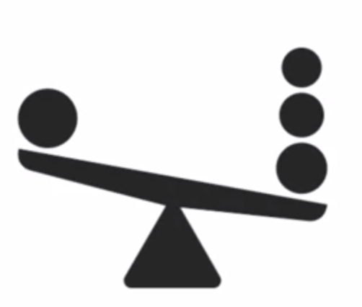
Balancing Cost and Complexity
The Grant Challenge for Data Scientist/ML Practitioners:
Balance complexity and cost
Notes:
And this is the biggest challenge in MLOps.
The biggest challenge for a Data scientists, Machine Learning engineering
How to find this perfect balance between cost and complexity.
This is the most important part!

Slide 27
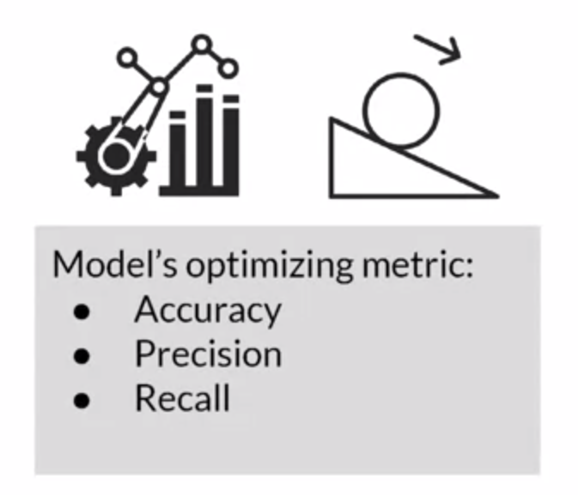
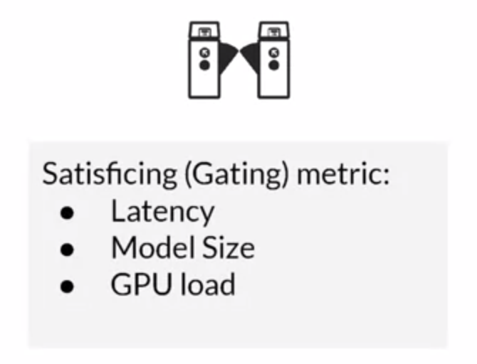
Optimizing and Satisfying Metrics
Notes:
Thats what I have been saying since lecture 1.
We want to optimize our ML metric but we need to account for our serving metrics toos!
Increasing one might potentially harm the other.
FInding that balance is very crucial!

Slide 28
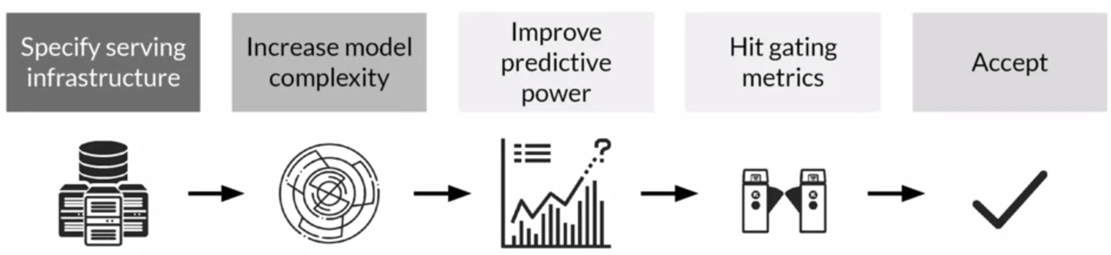
A common approach
Specifically define your infrastructure
CPU, GPU etc
Notes:
Ok. Lets now review a common approach on how to find that a balance.
We start on model scoping by picking our infrastructures. What resources we have and how much we can scale in case we want an increase. This is the first step when we start defining our project

Slide 29
A common approach
Specifically define your infrastructure
CPU, GPU etc
Start increasing the complexity
Notes:
Then we fit our benchmark, get the performance and slightly start increasing the complexity of the model to make tests!

Slide 30
A common approach
Specifically define your infrastructure
CPU, GPU etc
Start increasing the complexity
In order to increase predictive power
Notes:
We investigate if we get increased performance. Remember what we said on modelling. We start simple, and slightly we increase the complexity!

Slide 31
A common approach
Specifically define your infrastructure
CPU, GPU etc
Start increasing the complexity
In order to increase predictive power
Until you hit a one of your gating metrics
Notes:
As we slightly increase complexity we test when we are going to hit our gating metrics, our serving metrics specified in the beginning.
This is the limit. This is the highest prediction power we can get given our resources.

Slide 32
A common approach
Specifically define your infrastructure
CPU, GPU etc
Start increasing the complexity
In order to increase predictive power
Until you hit a one of your gating metrics
Either accept or start again
Notes:
Then either we accept or we try to come up with smart ways to get higer accuracy with the same number of resources. If we successed that would be great!

Slide 33

Caching
During a projects life cycle we constantly repeat data processing steps in different combinations
We need to minimize wasted work to maximize efficiency
What we do? We organize pipelines and caching.
Iteration efficiency: Reduce cost of frequent iteration
Increase productivity: Speeding up iteration frequency helps make problems faster
Reduce costs: Your monthly cloud bills will go way down!!
Notes:
Ok this is more for IT people but it is good to now.
When we constantly repeat the same steps over and over, its always very nice to apply caching!
We need to make sure that we dont spend our resources (an emplooyess time is still a resource) for nothing.
This is the job of a Data engineer! He is the one responsible for handling this kind of tasks.
Data engineers build the pipelines for the data! Its their job to maximize the efficiency and keep resources low!

Slide 34
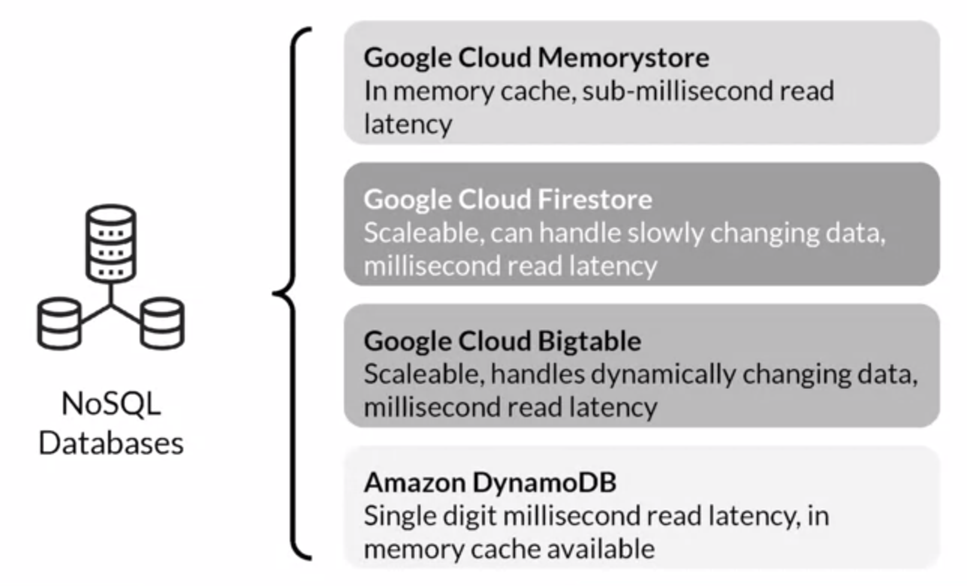
Caching and Feature Lookup
NoSQL databases are a good solution to implement caching.
Some examples:
Notes:
ok finaly I ll give some examples on how to actually implement caching.
Usually and as we will see in the next lecture, most cloud platforms have build-in caching services that we can implement.
Depending on what we want to cache, there is a different services. Not so important, please do not pay a lot of attention here

Slide 35
Deployment Options
Notes:
Allright good! any questions so far? Anything you want to add?
Nice, lets proceed on deployment. How to actually deploy our solutions!

Slide 36

Deployment Options
A centralized model
In a huge data center
Access is given by remote calls
Notes:
There are two main options to deploy our model.
The first on is to deploy it, by deploying I mean serving, In a huge data center.
In that case we have only a single centralized model that is saved somewhere
Users then make requests to this centralized model to get predcitons

Slide 37

Deployment Options
A centralized model
In a huge data center
Access is given by remote calls
Distribute unique instances of your model on embedded devices
Local loading
Phones, personal computers etc
Notes:
The second option is to have our model embedded in devices and distribute unique instances
Every user has a model on its own on his device

Slide 38
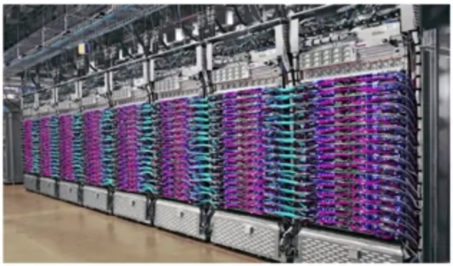
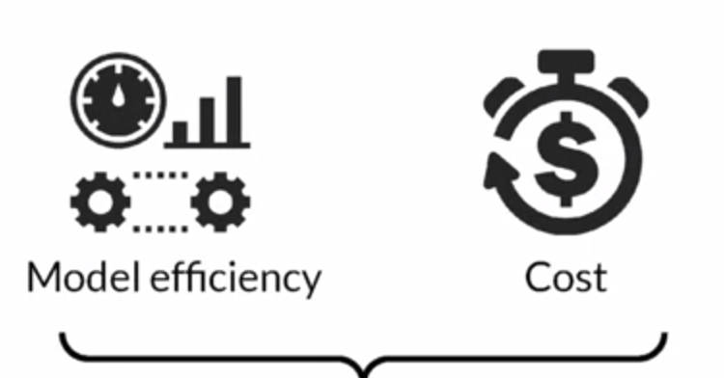
Running in Huge Data Centers
Big cloud providers
AWS
Google Cloud
Azure
They optimize resource utilization for you
They try to reduce running costs
Pay as you-go services
Notes:
Lets investigate the case for centralized models.
You have a big cloud provider like AWS Google cloud etc
You save your model to their servers
Every time a user wants to make a predictions he makes an API calls to these servers
Clouder providers are the ones responsible for optimizing the resources for you.
The good thing we this guys is that you pay only for what you need. Not extra!
Something we are going to talk about in hte next lecture

Slide 39
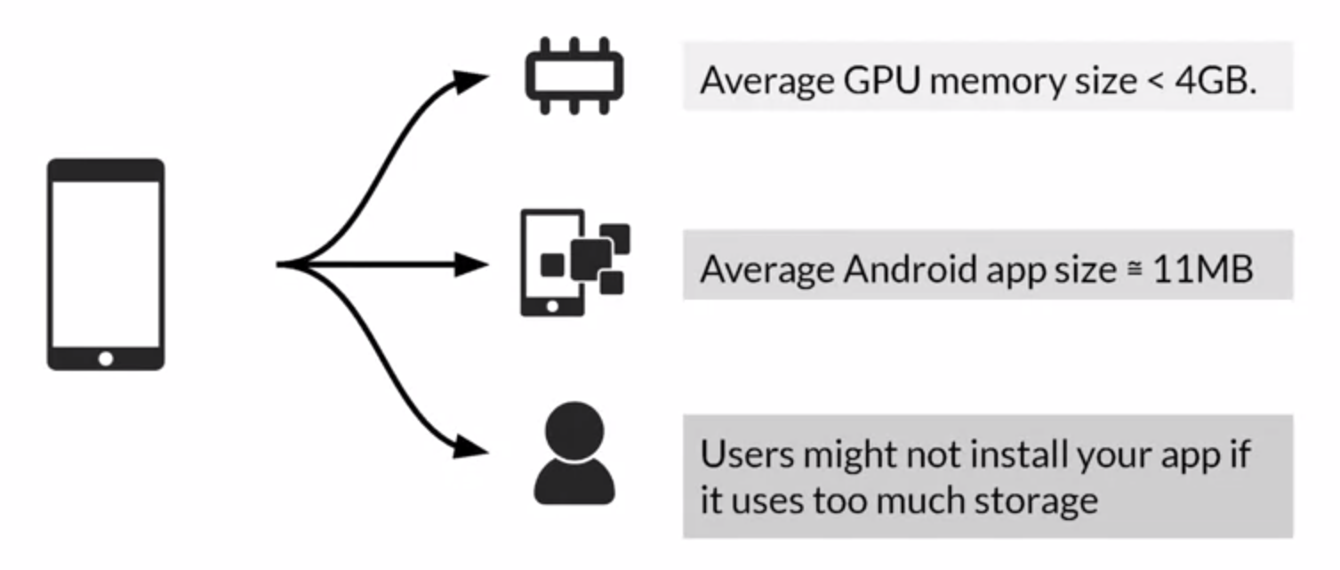
Phone devices
Huge Latency/Throughput gains
But
Notes:
Then when it comes to phone we have a great advantage
Its extremely fast! Requests do not have to pass through the web!
Inference speeds gains a lot of ground here
However.
It should be noted that the RAM and the cPU of these devices is not so big so bigger models struggle here!
And no one wants to have a super heavy application on its phone!!

Slide 40
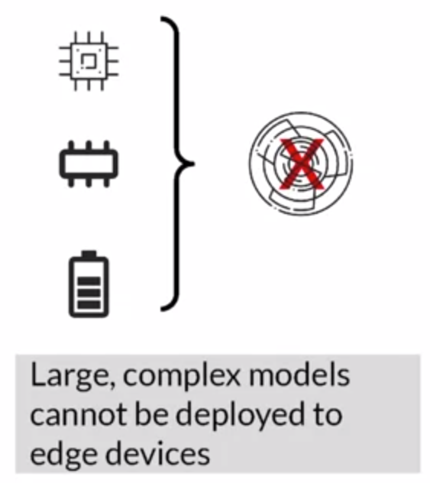
Constrained Environments
Local Devices
Notes:
Lets see the tradeoff between the two!
On a local device, having a very complex model is not an option. Local devices rarely have the hardware for such models

Slide 41
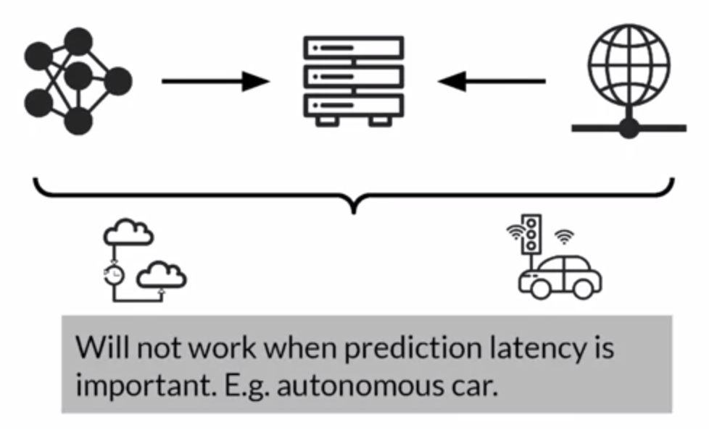
Constrained Environments
Local Devices
Cloud
Notes:
On the other hand, on cloud, you should pay attention that you might sacrifice a lot of latency to make it work. In cases you need decisions on the fly like a self-driving car it might be extremely costly!
Thats why self-driving cars have their own “brain”.

Slide 42
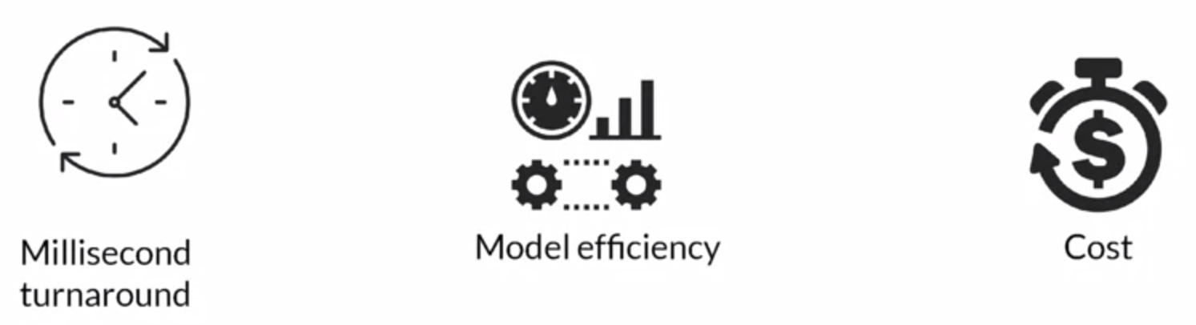
Prediction Latency is Almost Always Important
Opt for on-device inference whenever possible
Enhances user experience by reducing the response time of your app
Notes:
If you want to keep a rule of thumb here, keep in mind that latency is usually the most important thing. Its what we want to maximize.
For that reason having a relative simple model (as we said a GBDT) is usually a good way forward for local devices.
In general, when you can go for local devices. It maximizes inference and thus user experience
However when you cant reach the ML metric goal you have set, then cloud might be a better otpion

Slide 43
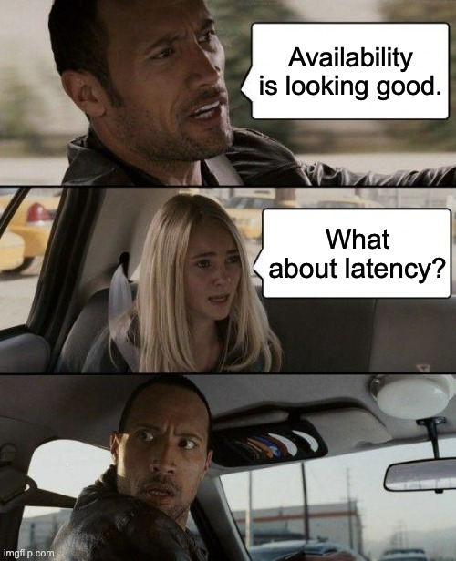
A quick tip
Always try to find the balance that is best for your application!!
Sacrificing accuracy might be the only solution
Have a clear goal in mind!!
Notes:
Allright to conclude this section!
People everything has to do with your application. Thats why in the beginning, during scoping, is extremely essential to decide which are your goals so you know what will be the selections you will make!

Slide 44
Cloud Deployment
Notes:
Allright now. Since we are on Lecture 10, lets make an introduction to the cloud…
What it looks like to use Cloud for Deploying your models.

Slide 45
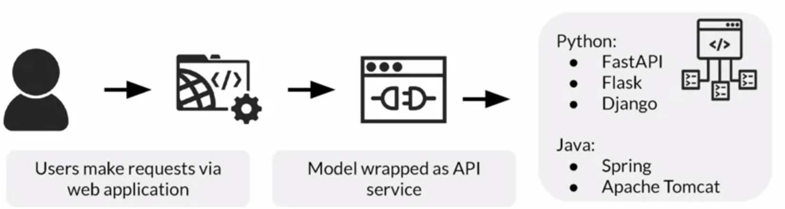
Web Application for Users
A typical cloud deployment pattern!
Users interact through a web platform with your application
You have a model wrapped in API service
When the user makes the request we “contact” the model to get the results!
Notes:
This is what we typically have when we have a model deployed in the c loud
Users have a webplatform. You can say streamlit!
You have a model wrapped in an API service (say using FastaPI)
When the user interacts with the platform to make a request, he contacts the model to get his results
This is the usual pipeline we have in our applications

Slide 46
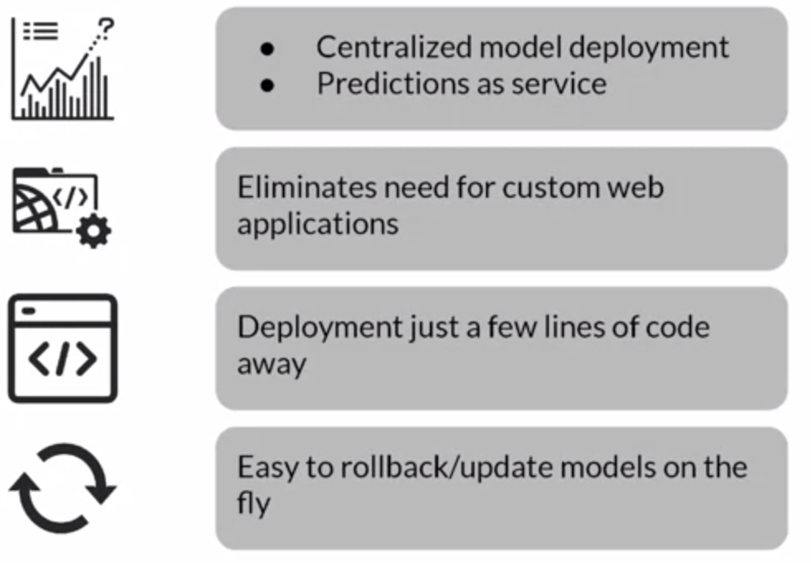
Serving Cloud Systems for easy deployment
Big cloud providers
AWS
Google Cloud
Azure
Smaller - faster deployment options
Streamlit
Notes:
In general, cloud systems are very good for easy deployments at scale.
You have big providers like AWS, Google Cloud etc that can serve a lot of customers with minimum effort!
Then you have streamlit if you hand hundrendts of users
As you go to thousands, you will need to switch to the goal
We see some of the good things about the cloud.
You pay-as-you. Each prediction is what you are paying for
You dont need to design your own web application
You can easily deploy your model with just a few lines of code
And if something does not work, you can easily rollback to a previous version of your model!

Slide 47
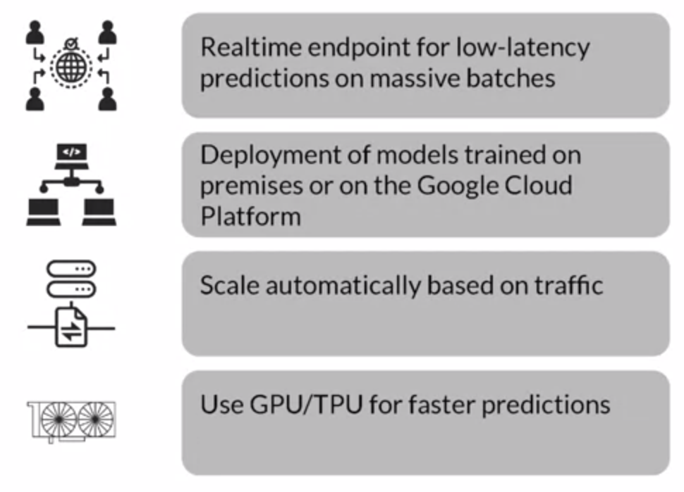
Advantages of Serving with a Managed Service
Set realtime endpoints
Allows for deployment of models trained anywhere
Scale automatically
(in reduced costs)
pick your accelerators
Notes:
Now lets see some extra advantages
On cloud you can have realtime endpoints. Say you want to have some predictions ready on Monday morning to make some orders. You can set your pipeline to have batch predictions at Sunday night so everything is ready for Monday
You can serve your models from anywhere. Either they are trained on the cloud, or in your local machine
You scale automatically. That means the more costumers come, you dont have to worry about buying new CPUs. Cloud just assigns more resources to your end!
You cna easily shop whatever GPUs, TPUs you want with worrying about installing or anything like that

Slide 48
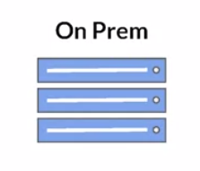
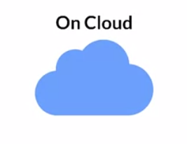
Model Serving Infrastructures
Train and deploy on your own hardware
Manually procure hardware, GPUs, CPUs
Profitable for companies running ML projects for longer times
Can use open source, pre build servers
Train and deploy on cloud choosing from several service providers
AWS, Google Cloud, Azure etc
Crate VMs and use open source pre build servers
Use the provided ML workflow
Notes:
Lets review it a bit here.
On Prem we mean train and deploy your model on your own hardware! You have your own servers, your own computers etc
This is good if you a simple ML app and you run it for a lot of time so you have perfect knowledge of what going on
On the other hand you have the cloud where you can easily deploy a new or more new applications

Slide 49
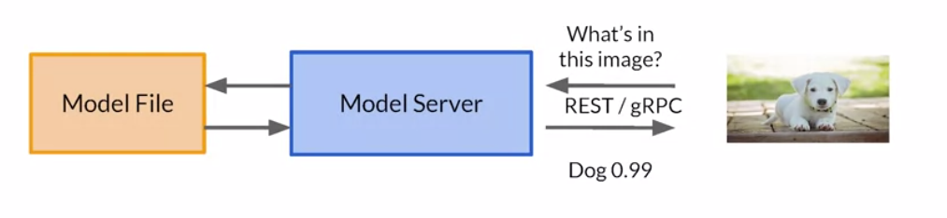
Model servers
Simplify the task of deploying ML models at scale
Can handle scaling, performance, some model lifecycle management
Paying only for the resources and services you use (pay-as-you-go)
Notes:
Oke from this slide I want for you to keep that using the Cloud you dont have to worry about scaling or billing. You only pay whatever you use.
You rent a server somewhere and everytime you make an action you are billed an amount.

Slide 50
Scaling Infrastructure
Notes:
Good. Now that we have that cleaned lets move to scaling!

Slide 51
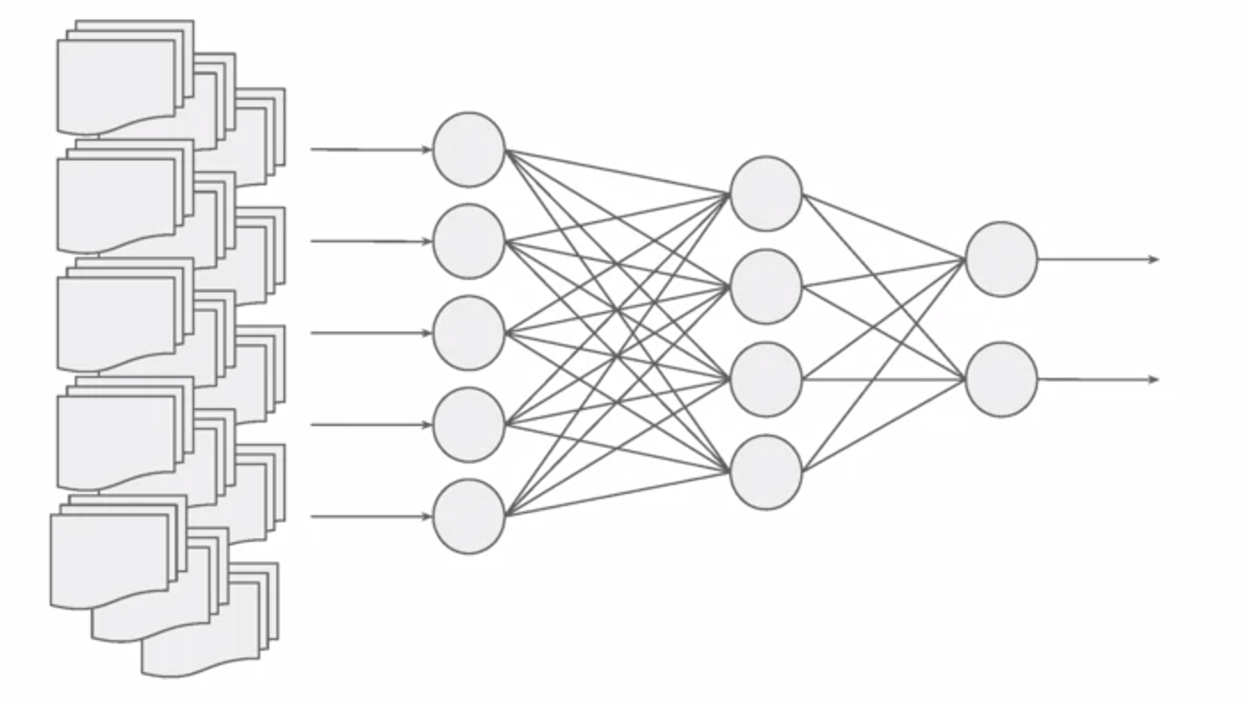
Why is Scaling Important?
Consider a very complex model
Then consider the cost of training a very large Neural Network on huge datasets.
(Take chatGPT for example)
It take days to train on a single machine.
So what we do?
We distribute training to multiple instances
(Partition GPUs and CPUs)
Notes:
Oke, first of all lets find out why scaling is important
Say we have a very complex model.
In order to train this model we need to have a big enough dataset that will lead to good training
How do we handle this?
How do we handle training complex models on huge datasets
Well there are many tricks. One of the most go-to tricks is training distribution. Distribute training to multiple instances by partitioning GPUs and CPUs.
So you split your data into many CPUs and GPUs

Slide 52
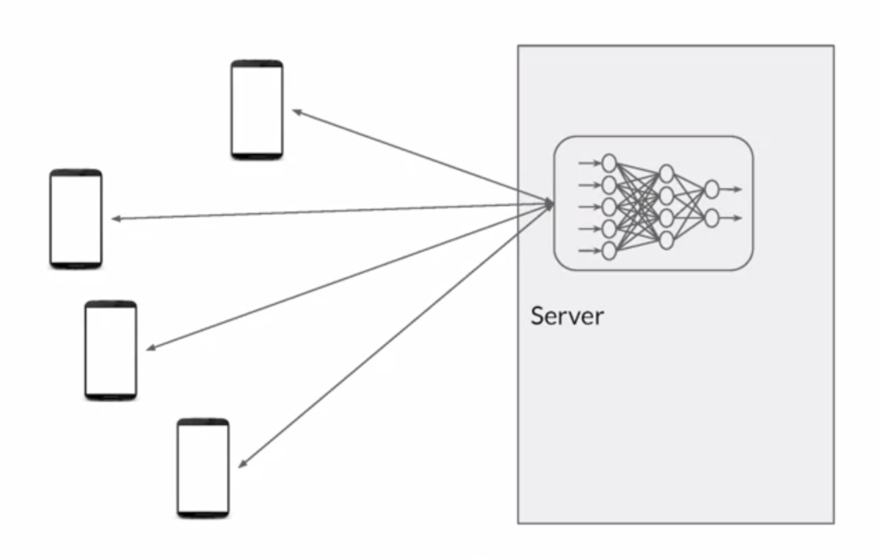
Why Scaling is Important
The same is true for inference after deployment
Huge number of requests
Server might go down
Scaling both runtime inference
and training is fundamental
Notes:
This is true for inference too! When we have too many costumers we want to scale our inference too. We want to make multiple predictions fast at the same time!

Slide 53
How to Scale?
Notes:
So the question becomes? How do we scale? How do we effectively increase or hardware to deal with these issues!

Slide 54
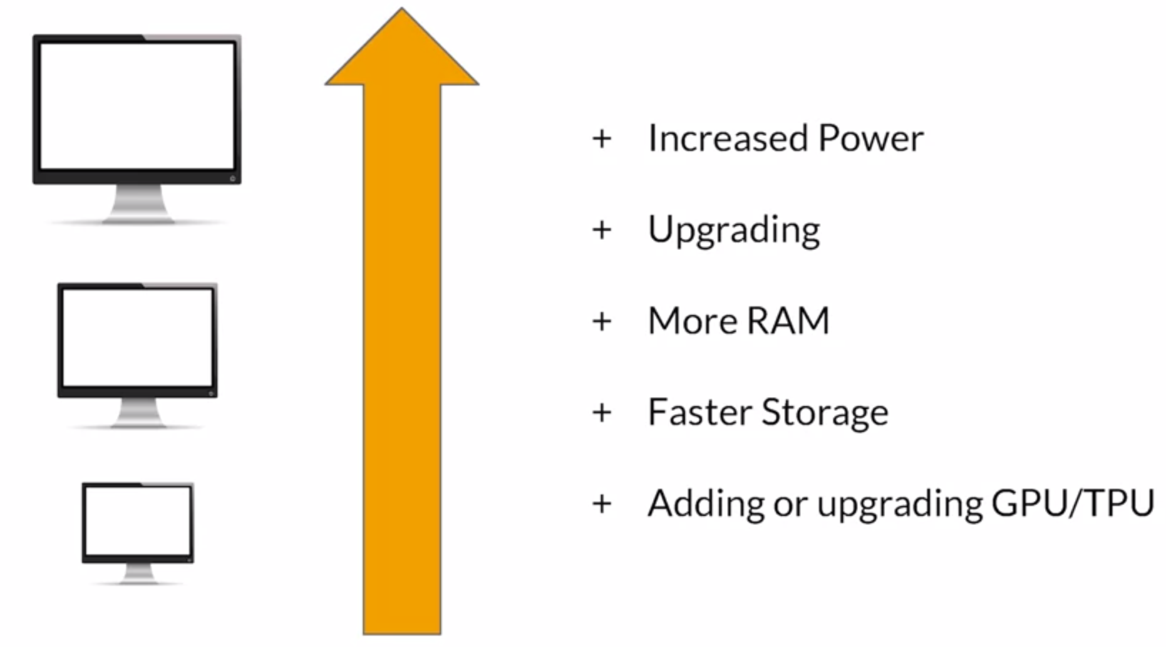
Vertical Scaling
Upgrade your computer
Notes:
There are twoo ways!
First we have vertical scaling.
We simply upgrade our computer. We add more RAM, more CPUs, etc
So we invest in updating our single computer

Slide 55
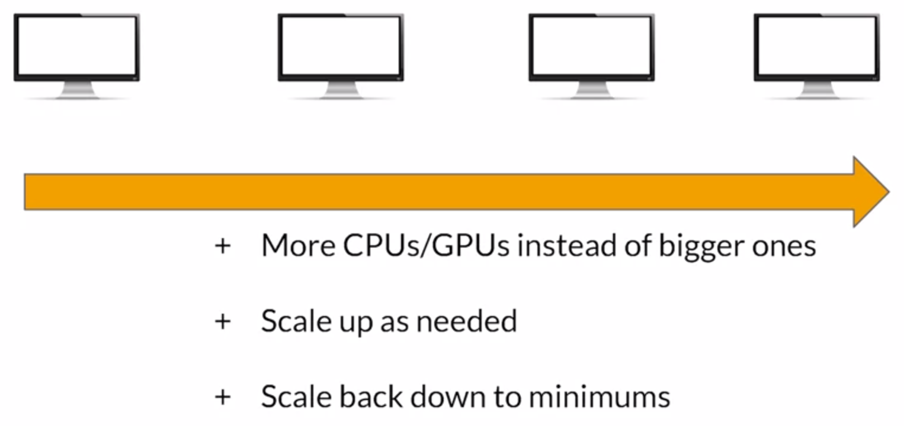
Horizontal Scaling
Add more computers
Notes:
Then we have horizontal scaling.
What happens here is that add more computers to our servers
In simple words, instead of buying better CPUs, we just add more!
We add as many computers as we want, and then we scale back when we meet our requirements.

Slide 56
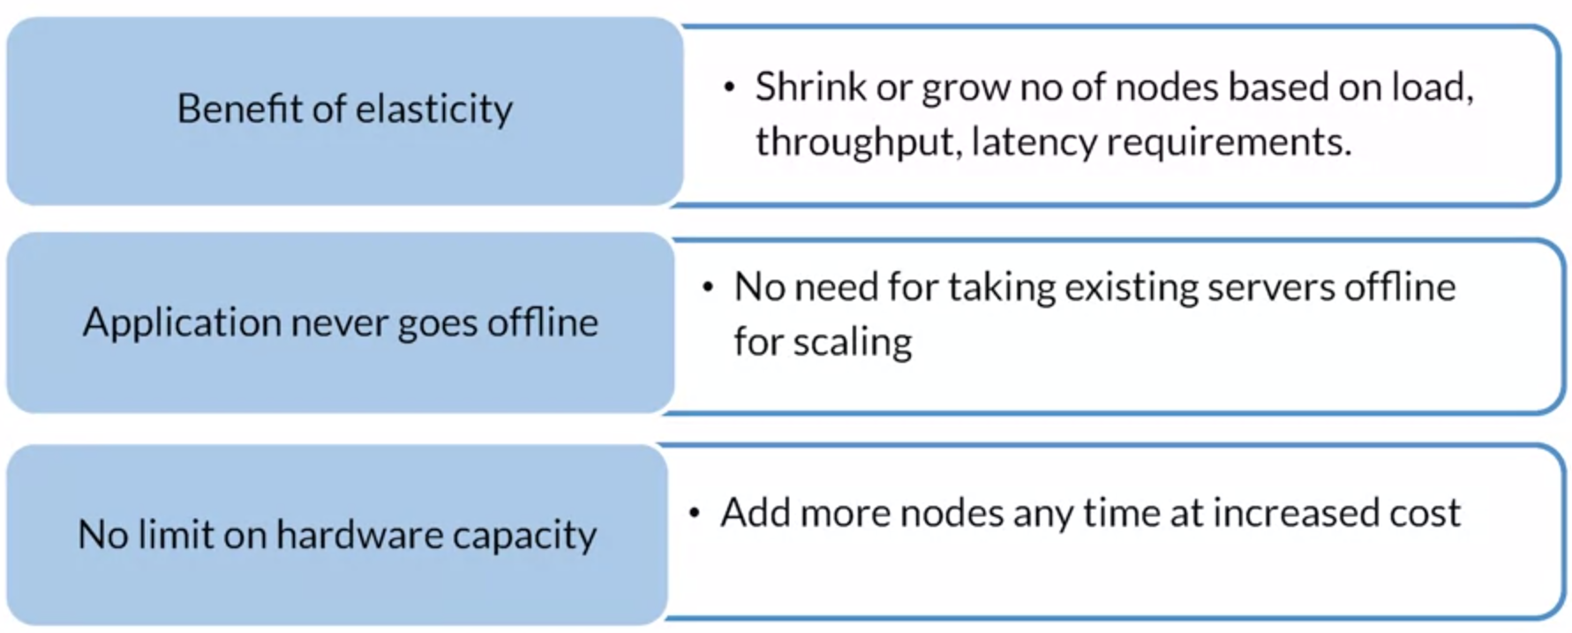
Why Horizontal over Vertical Scaling
Notes:
What usually is the go-to nowadays is horizonta scaling over vertical scaling for a number of reasons
First you can grow as much as you need, not mor enot less
Its not required to close your server, you simply add more computers!
There is no upper threshold. For example on a singmple computer you can only reach a limit and then cannot scale more!

Slide 57
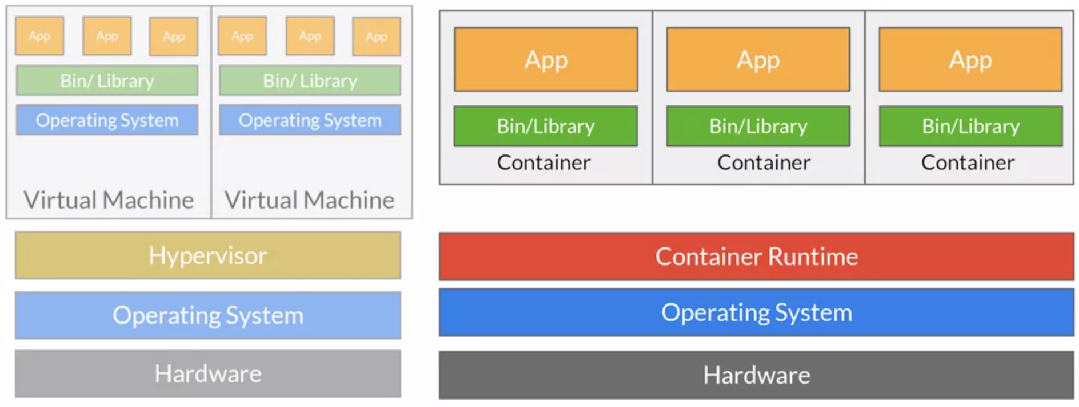
Docker: Containers and Virtual Machines
Notes:
We talked about containers and Virtual Machines
This is where they come into place!
You have simple machine and you just add more containers!

Slide 58
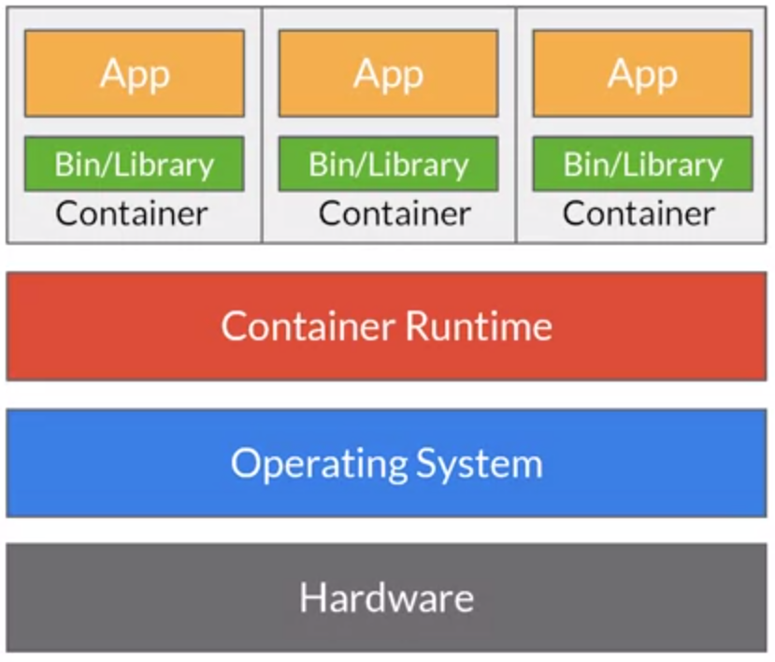
Container Advantages
Less OS requirements - more apps
Abstraction
Easy deployment based on container runtime
Docker as the container service
Can be used in data centers, personal machines or public cloud
It partners with major cloud services
Notes:
Agai, we have talked about these no need to invest more time here1

Slide 59
Inference!
Notes:
Instead lets move to inference!
Lets try to understand what inference is here!

Slide 60
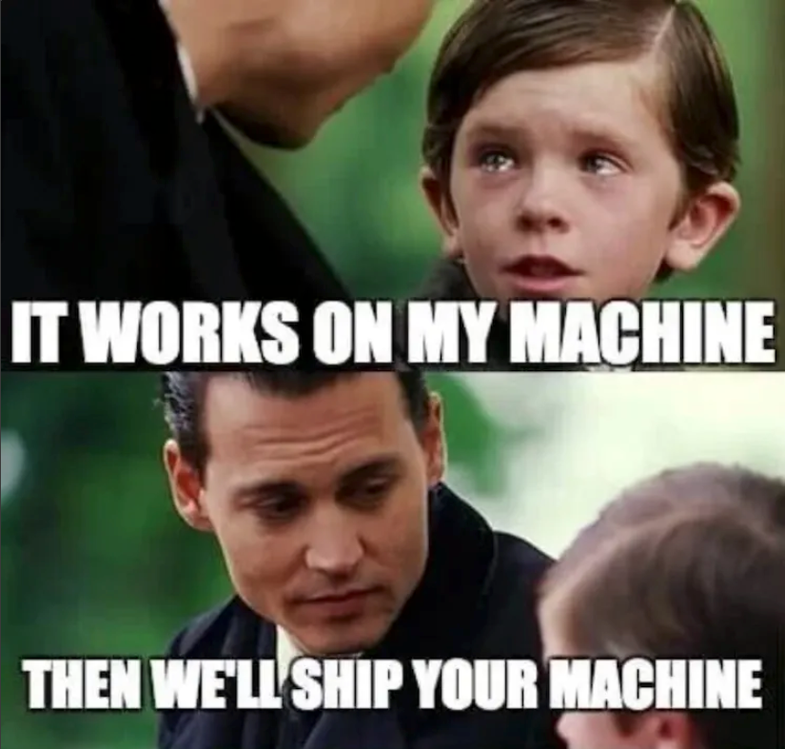
Two types of Inference
Online Inference
Batch Inference
Notes:
We talked about two types of inference!
We have online and batch inference!
this is a nice meme about reproducibility
Something might work for your computer but its not supposed to work everywhere! remember that

Slide 61
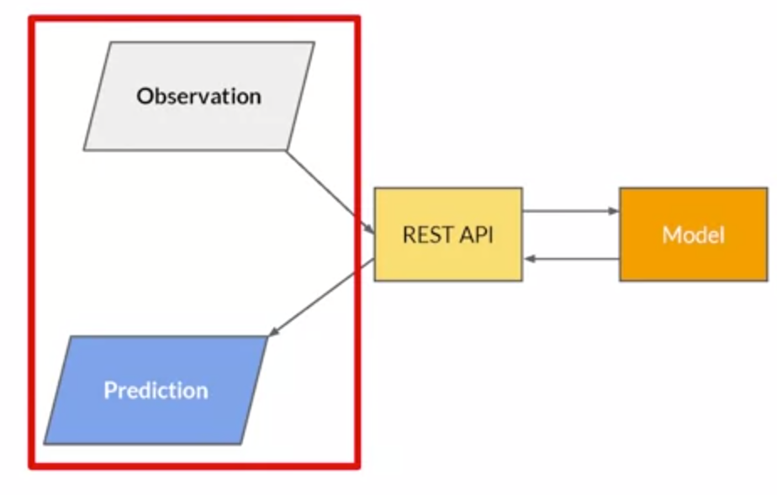
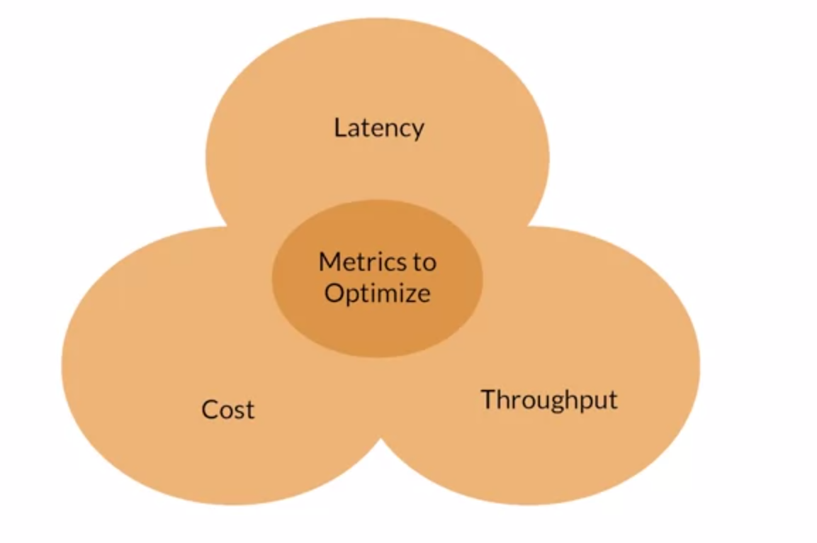
Optimizing ML Inference
The user only experiences delays when he passes the data and waits for the results
But latency is not only that.
Passing input data to the model might needs preprocessing
A purely designed app with a perfect model will still result in major delays
Takeaway: Manage latency at every stage of the application
Notes:
Lets see how to optimizing latency for Online Inference
User “feels” the latency when he passes his data and waits for the results
But as we said its not that simple. We might have a huge pipeline that the data needs to go through before making a prediction
So always try to optimize latency on the entire application not only the model
This is why we had the lecture on production-level code and how we can optimize our code for that!

Slide 62
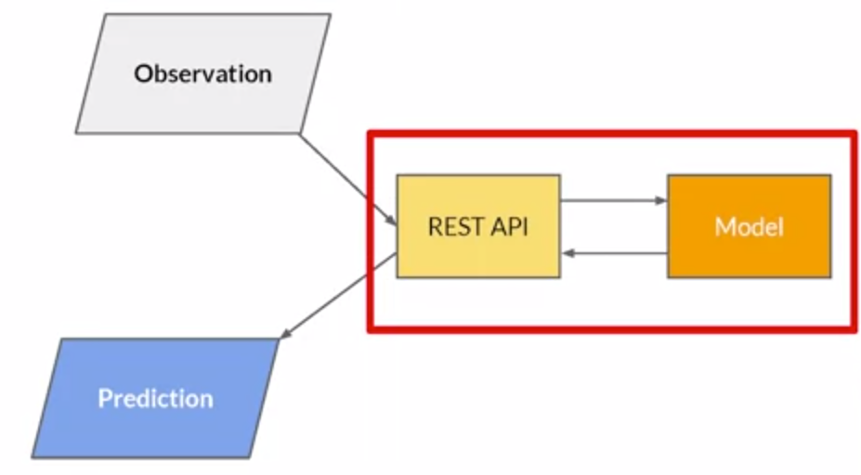
Optimizing ML Inference
Throughput is most important to optimize on non customer facing systems like intensive data processing apps
Notes:
Next on Throughput.
Throughput is very important on applications where we dont have costumers or users. This can be a self-driving car, a camera, etc
Where we want to satisfy as many events as possible in as little time as possible!

Slide 63
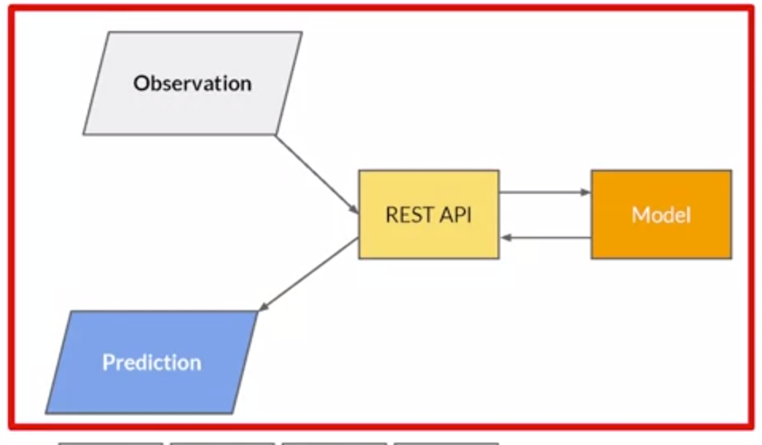
Optimizing ML Inference
Multiple costs in the system
Hardware
Engineering testing time and effort
Software licences
Research costs
Keep everything into account
Notes:
Finally we have costs!
Costs comes from difference sources.
We have to manager our hardware, our software, we need to pay the bills for the guys to set up our pipeline etc
Everything should be taken into account

Slide 64
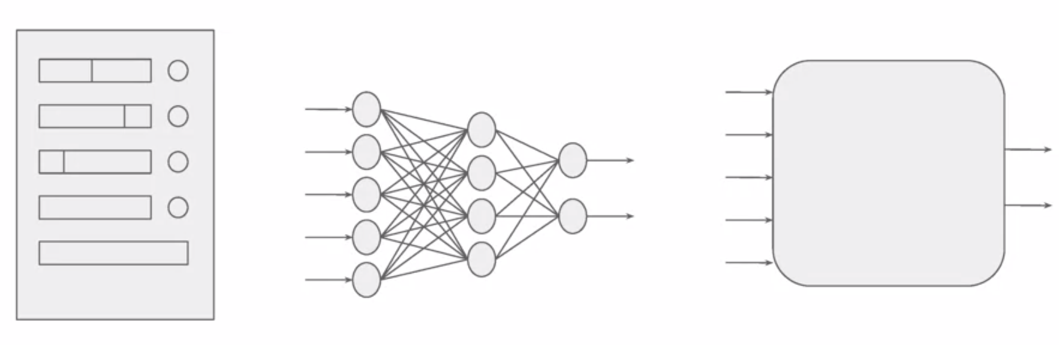
Inference Optimization
Three main areas to optimize your inference
Notes:
There are three areas where we can work on to optimize our inference times

Slide 65
Inference Optimization
Infrastructure
Where we serve the model
Scaled either vertically or horizontally
Depends on the specifics of the application
Notes:
First we have the infrstarcutre
We need to make sure we find the right place to server our model.
Cloud or Local device?
We need to make sure we make the right selection to scale effectively (horizonta is the go-to more medium-large applications)

Slide 66
Inference Optimization
Model Architecture
Upgrade/downgrade model architecture
Requires architecture understanding
(Often) there is a tradeoff between inference speed and accuracy.
For example if a 99% accurate model is 10 times slower than a 98% accurate model, is it worth the cost?
Notes:
Then we have the model we use to make our predictions
How much complexity do we need to satisfy our metrics?
There is a tradeoff between having high inference speed and accuracy
Consider the example. In order to gain a 1% accuracy improvement we make a 10times slower model. Is that something we want??
Always look for tha perfect tradeoff, that balance for your application

Slide 67
Inference Optimization
Model Compilation
Post-training step:
Creates a model artifact and a model execution module
Optimizes the model inference to match your underlying hardware.
(GPU)
If I know where I deploy my model I can align their inference.
Notes:
Finally we have the inference stage.
When we we finish training how do we make sure that our model matches the hardware we have to get as fast predictions as possible?
This is why production level code and having knowledge of all the stuff we talked on our previous lectures is very important.

Slide 68
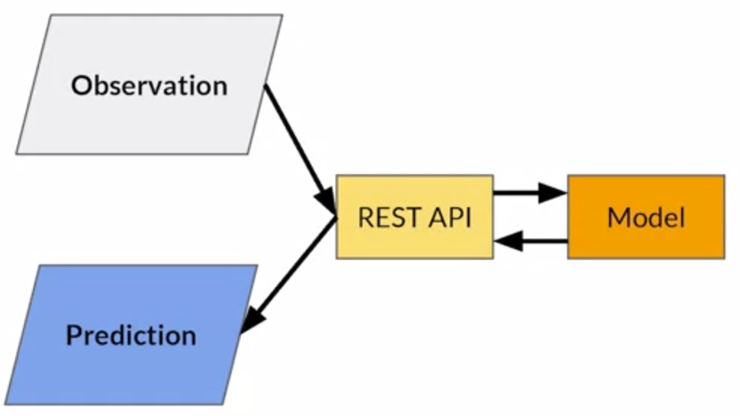
Introduction to Online Inference
Process of generating machine learning predictions in real time upon request
Predictions are generated on a single observation of data at runtime
Can be generated at any time of the day on demand
Notes:
Allright lets see a small introduction to online inference
STarting with Online inference
In online inference you make predictions in real time
Observations come and you get a predictions until you want to pause it
This is happening sequantily, one predictions at the time!

Slide 69
Batch Inference
Notes:
Good now moving to batch inference.
Its a bit more used in practise so we going to invest a bit more here

Slide 70
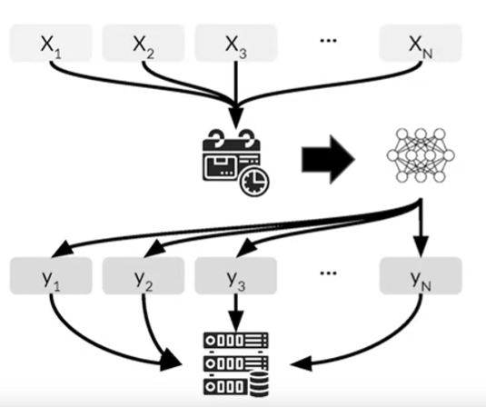
Batch Inference
Generating predictions on a batch of observations
Batch jobs are often generated on a recurring schedule
Predictions are then stored and made available to the end user
Used when predictions are not required (or is not feasible to be generated) on real time
Usually applied on non-automated decision making
Notes:
This is usually the process on batch inference.
We give the model a batch of input data and we wait for it to make predictions.
Usually we have set our model to make predictions at specific times on a week or daily
We then store these predictions somewhere and we make them available for the user when we want to
Batch predictions is used when it takes a lot of time to make predictions in real time
Or when we dont have to.
Consider for example cases where a human makes a decision based on the results of a model. This is where batch predictions are helpful!
On automated tasks, online inference is more usefull

Slide 71
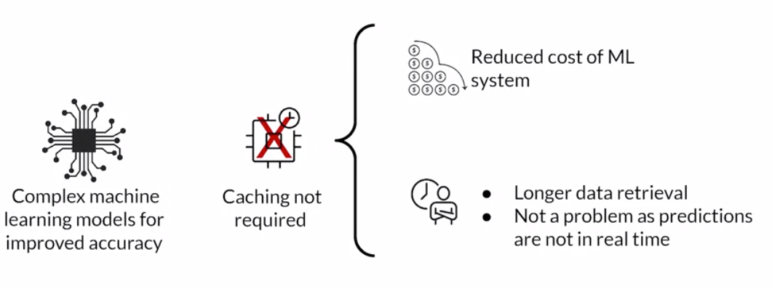
Advantages of Batch Inference
No constraints on inference time
(eg Predictions for Mondays are generated on Sunday)
Reduced costs!
Notes:
Some advantages!
First we dont have to worry for inference time! We can make predictions on a Monday and use them on Sunday
Secondly we dont have to cache. We dont have to worry on how much it will take to load my model or data to make a prediction
That leads to reduce costs. Something very useufll on big complex pipelines and architectures

Slide 72
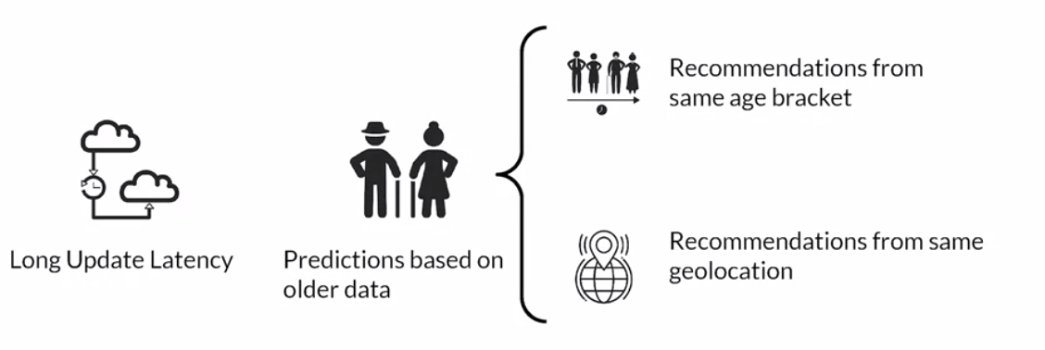
Limitations of Batch Inference
Predictions cannot made available for real-time purposes
For example, assume Netflix uses batch inference. When you sign-up, you wont get on-the-fly recommendations.
You will take your recommendations when the new batch of predictions has been arrived!
To get around we need workaround (same age, geolocation)
Notes:
On the other hand we have some limitations
Most importantly, given the high latency we cannot use them for real-time purposes
If you consider Spotify or Netflix and you want to get a recommendation, you wont get a new recommendation based a new movie you have picked. You will get a recommendation from the set of movies you watch yesterday as predictions were made this morning
So its a bit tougher for real-time predictions. You rely more on historical data, what we liked yesterday rather on what we like today!

Slide 73
Important Metrics to Optimize
Most important metric to optimize while performing batch predictions:
Throughput
Prediction service should be able to handle large volumes of inference at a time
Predictions are not needed to be made available immediately
Latency can be compromised
Notes:
Ok and since we dont worry about latency, we need to worry about throughput.
We want to get as many predictions as possible in a limited time to reduced costs
I dont want my server to run forever so I just open it, give it a banch of data and wait for predictions. The more data I can process at once the better results I have
So keep in mind. For batch predictions we worry for throughput and not latency!

Slide 74
How to increase Throughput
The easiest way:
Use hardware accelerators like GPUs, TPUs
Increase number of servers/workers
Load several instances of the model on multiple workers
Notes:
Alright. We talked about decreasiny latency. Lets quickly see how we can increase throughput.
No big differences! You scale horizontally and vertically!
First of all you get some better accelerators like a better GPU or TPU
Then you have many workers to parellize your application.
Same like latency in some sence

Slide 75
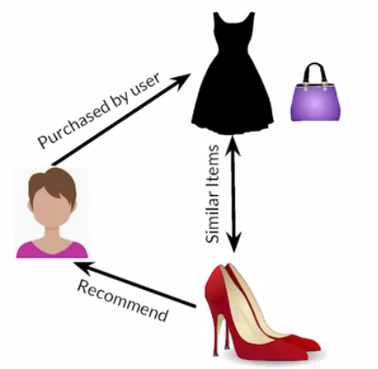
Use Case: Product Recommendations
E-commerce sites: new recommendations on a recurring schedule
Cache these for easy retrieval
Enables use of more predictors to train more complex models
Helps personalization to a greater degree but with delayed data
Notes:
Now lets see some examples for batch predictions!

Slide 76
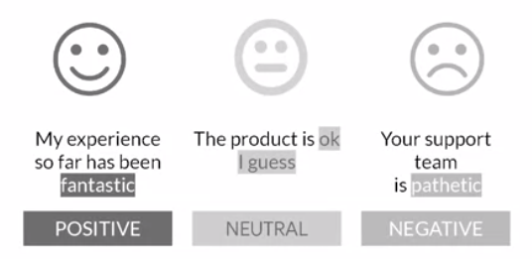
Use Case - Sentiment Analysis
User sentiment based on costumer review
Non need for realtime predictions for this problem
Pretrained LLMs can be easily be used for this problem
Complex models, but far more accurate than say LSTM
Most cost-effective with batch prediction and caching

Slide 77

Use Case: Demand Forecasting
Estimate the demand for products for inventory and ordering optimization
Predict future based on historical data (time series data)
Many models available as this is a batch predictions problem

